Slide 1
Lecture 1 – Course Introduction
CSD2170 Programming Massively Parallel Processors
Lecture 1.1 - Course Introduction and Overview

Slide 2
Course Goals
Demonstrate knowledge of typical GPU architectures, understanding the challenges in parallel programming, parallel programming languages and models (CUDA C/C++) as well as shader programming models Technical subjects
Become proficient in shader programming using a shader language
Given a problem typically implemented on CPUs, speedup real applications by programming for different parallel computation patterns and develop an efficient parallel algorithm and implement it on GPUs
Given a problem, implement an efficient and correct code to solve it, analyze its performance, and give convincing written and oral presentations explaining your work
Programming in CUDA C/C++
Reference
The GPU Teaching Kit is licensed by NVIDIA and the University of Illinois under the Creative Commons Attribution-NonCommercial 4.0 International License.

Slide 3
Course Content
Week 1 Course Introduction Introduction to CUDA C CUDA Parallelism Model | Course Introduction and Overview Introduction to CUDA C CUDA Parallelism Model
Week 2 CUDA Performance | CUDA performance: Memory Model and Locality, Thread Execution Efficiency
Week 3 CUDA Performance | ​CUDA performance: Memory Access Performance, Atomic Operations
Week 4 Parallel Patterns | Parallel Patterns
Week 5 Shader Programming | Review of the modern computer graphics programmable pipeline, API, compatible shader language Introduction to Vulkan Compute Shader
Week 6 Vulkan Synchronization and Computer Shader Application | Vulkan Synchronization Computer Shader Application

Slide 4
Course Content
Week 8 Computer Shader Application | Compute Shader Application
Week 9 Tessellation Shader | Introduction to Tessellation stage
Week 10 Tessellation Shader Applications | Tessellation Shader Applications
Week 11 Geometry Shader | Geometry Shader
Week 12 Geometry Shader Applications | Geometry Shader Applications
Week 13 Advanced Topics for GPGPU Programming | CUDA programming advanced topics
Week 14,15 | Finals

Slide 5
Lecture 1 – Course Introduction
CSD2170 Programming Massively Parallel Processors
Lecture 1.2 - Introduction to Heterogeneous Parallel Computing

Slide 6
Objectives
To learn the major differences between latency devices (CPU cores) and throughput devices (GPU cores)
To understand why winning applications increasingly use both types of devices

Slide 7
Heterogeneous Parallel Computing
Use the best match for the job (heterogeneity in mobile SOC)
Cloud Services
Latency Cores
Throughput Cores
HW IPs
DSP Cores
Configurable
Logic/Cores
On-chip Memories

Slide 8
CPU and GPU are designed very differently
CPU
Latency Oriented Cores
GPU
Throughput Oriented Cores
Chip
Chip
Core
Compute Unit
Local Cache
Cache/Local Mem
Registers
Registers
SIMD Unit
Threading
Control
SIMD Unit

Slide 9
CPUs: Latency Oriented Design
Control
ALU
ALU
Powerful ALU
Reduced operation latency
Large caches
Convert long latency memory accesses to short latency cache accesses
Sophisticated control
Branch prediction for reduced branch latency
Data forwarding for reduced data latency
ALU
ALU
CPU
Cache
DRAM

Slide 10
GPUs: Throughput Oriented Design
Small caches
To boost memory throughput
Simple control
No branch prediction
No data forwarding
Energy efficient ALUs
Many, long latency but heavily pipelined for high throughput
Require massive number of threads to tolerate latencies
Threading logic
Thread state
GPU
DRAM

Slide 11
Winning Applications Use Both CPU and GPU
CPUs for sequential parts where latency matters
CPUs can be 10X+ faster than GPUs for sequential code
GPUs for parallel parts where throughput wins
GPUs can be 10X+ faster than CPUs for parallel code

Slide 12
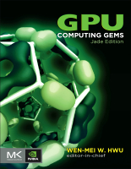
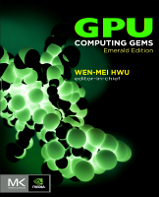
GPU computing reading resources
90 articles in two volumes

Slide 13
Heterogeneous Parallel Computing in Many Disciplines
Financial Analysis
Scientific Simulation
Engineering Simulation
Data Intensive Analytics
Medical Imaging
Digital Audio Processing
Digital Video Processing
Computer Vision
Biomedical Informatics
Electronic Design Automation
Statistical Modeling
Numerical Methods
Ray Tracing Rendering
Interactive Physics

Slide 14
Lecture 1 – Course Introduction
CSD2170 Programming Massively Parallel Processors
Lecture 1.3 - Portability and Scalability in Heterogeneous Parallel Computing

Slide 15
Objectives
To understand the importance and nature of scalability and portability in parallel programming

Slide 16
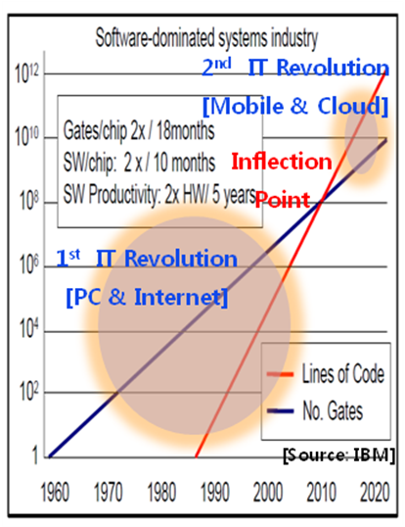
Software Dominates System Cost
SW lines per chip increases at 2x/10 months
HW gates per chip increases at 2x/18 months
Future systems must minimize software redevelopment

Slide 17
Keys to Software Cost Control
Scalability
App
Core A

Slide 18
Keys to Software Cost Control
Scalability
The same application runs efficiently on new generations of cores
App
Core A 2.0

Slide 19
Keys to Software Cost Control
Scalability
The same application runs efficiently on new generations of cores
The same application runs efficiently on more of the same cores
App
Core A
Core A
Core A

Slide 20
More on Scalability
Performance growth with HW generations
Increasing number of compute units (cores)
Increasing number of threads
Increasing vector length
Increasing pipeline depth
Increasing DRAM burst size
Increasing number of DRAM channels
Increasing data movement latency
The programming style we use in this course supports scalability through fine-grained problem decomposition and dynamic thread scheduling

Slide 21
Keys to Software Cost Control
Scalability
Portability
The same application runs efficiently on different types of cores
App
App
App
Core B
Core A
Core C

Slide 22
Keys to Software Cost Control
Scalability
Portability
The same application runs efficiently on different types of cores
The same application runs efficiently on systems with different organizations and interfaces
App
App
App

Slide 23
More on Portability
Portability across many different HW types
Across ISAs (Instruction Set Architectures) - X86 vs. ARM, etc.
Latency oriented CPUs vs. throughput oriented GPUs
Across parallelism models - VLIW vs. SIMD vs. threading
Across memory models - Shared memory vs. distributed memory

Slide 24
Lecture 1 – Introduction to CUDA C
CSD2170 Programming Massively Parallel Processors
Lecture 2.1 - CUDA C vs. Thrust vs. CUDA Libraries

Slide 25
Objective
To learn the main venues and developer resources for GPU computing
Where CUDA C fits in the big picture

Slide 26
3 Ways to Accelerate Applications
Applications
Libraries
Compiler Directives
Programming Languages
Easy to use
Most Performance
Easy to use
Portable code
Most Performance
Most Flexibility

Slide 27

Libraries: Easy, High-Quality Acceleration
Ease of use: Using libraries enables GPU acceleration without in-depth knowledge of GPU programming
“Drop-in”: Many GPU-accelerated libraries follow standard APIs, thus enabling acceleration with minimal code changes
Quality: Libraries offer high-quality implementations of functions encountered in a broad range of applications
Notes:
Developing applications around libraries offers a range of benefits:
- Being callable from your host application, the CUDA accelerated libraries can hide a lot of the architectural details of the GPUs and therefore significantly shorten your application development
cycle.
CUDA-accelerated libraries often use APIs similar to well established libraries widely used
in scientific applications, thus enabling a drop-in acceleration experience. In some cases, the
libraries will offer exactly the same interface for both the GPU accelerated Version and the CPU
only version, resulting in code portable between the worlds. In other cases, some with a minimal
amount of code changes will be necessary to accommodate both CPU and GPU support.
Designing an application around libraries is also good software engineering practice, as it
reuses well tested code and therefore enhancing the overall quality of your application.
- Finally, CUDA accelerated libraries developed by NVIDIA engineers are highly tuned for
Performance, delivering excellent performance on every generation of GPUs, while maintaining generality.

Slide 28














GPU Accelerated Libraries
Linear Algebra
FFT, BLAS,
SPARSE, Matrix
NVIDIA
cuFFT,
cuBLAS,
cuSPARSE
Numerical & Math
RAND, Statistics
NVIDIA
Math Lib
NVIDIA cuRAND
Data Struct. & AI
Sort, Scan, Zero Sum
GPU AI – Board Games
GPU AI – Path Finding
Visual Processing
Image & Video
NVIDIA
Video Encode
NVIDIA
NPP
Notes:
GPU Accelerated libraries provide “drop-in” acceleration for your applications.
There are a wide variety of computational libraries available. You are probably familiar with the FFTW fast fourier transform library, the various BLAS linear algebra libraries,
the Intel Math Kernel Library, or Intel Performance Primitives library, to name a few. There are compatible GPU-accelerated libraries available as drop-in replacements
for all of the libraries I just mentioned, and many more.
cuBLAS is NVIDIA’s GPU-accelerated BLAS linear algebra library, which includes very fast dense matrix and vector computations.
cuFFT is NVIDIA’s GPU-accelerated Fast Fourier Transform Library.
cuRAND is NVIDIA’s GPU-accelerated random number generation library, which is useful in Monte Carlo algorithms and financial applications, among others.
cuSPARSE is NVIDIA’s Sparse matrix library, which includes sparse matrix-vector multiplication, fast sparse linear equation solvers, and tridiagonal solvers.
NVIDIA Performance Primitives includes literally thousands of signal and image processing functions.
Thrust is an open-source C++ Template library of parallel algorithms such as sorting, reductions, searching, and set operations.
And there are many more libraries available from third-party developers and open source projects.
GPU-accelerated libraries are the most straightforward way to add GPU acceleration to applications, and in many cases their performance cannot be beat.

Slide 29
Vector Addition in Thrust
thrust::device_vector<float> deviceInput1(inputLength); thrust::device_vector<float> deviceInput2(inputLength); thrust::device_vector<float> deviceOutput(inputLength);
thrust::copy(hostInput1, hostInput1 + inputLength, deviceInput1.begin());
thrust::copy(hostInput2, hostInput2 + inputLength, deviceInput2.begin());
thrust::transform(deviceInput1.begin(), deviceInput1.end(), deviceInput2.begin(), deviceOutput.begin(),
thrust::plus<float>());
https://docs.nvidia.com/cuda/thrust/index.html

Slide 30
Compiler Directives: Easy, Portable Acceleration
Ease of use: Compiler takes care of details of parallelism management and data movement
Portable: The code is generic, not specific to any type of hardware and can be deployed into multiple languages
Uncertain: Performance of code can vary across compiler versions
Notes:
Developing applications around libraries offers a range of benefits:
- Being callable from your host application, the CUDA accelerated libraries can hide a lot of the architectural details of the GPUs and therefore significantly shorten your application development
cycle.
CUDA-accelerated libraries often use APIs similar to well established libraries widely used
in scientific applications, thus enabling a drop-in acceleration experience. In some cases, the
libraries will offer exactly the same interface for both the GPU accelerated Version and the CPU
only version, resulting in code portable between the worlds. In other cases, some with a minimal
amount of code changes will be necessary to accommodate both CPU and GPU support.
Designing an application around libraries is also good software engineering practice, as it
reuses well tested code and therefore enhancing the overall quality of your application.
- Finally, CUDA accelerated libraries developed by NVIDIA engineers are highly tuned for
Performance, delivering excellent performance on every generation of GPUs, while maintaining generality.

Slide 31
OpenACC
Compiler directives for C, C++, and FORTRAN
#pragma acc parallel loop copyin(input1[0:inputLength],input2[0:inputLength]), copyout(output[0:inputLength])
for(i = 0; i < inputLength; ++i) {
output[i] = input1[i] + input2[i];
}

Slide 32
Programming Languages: Most Performance and Flexible Acceleration
Performance: Programmer has best control of parallelism and data movement
Flexible: The computation does not need to fit into a limited set of library patterns or directive types
Verbose: The programmer often needs to express more details

Slide 33
GPU Programming Languages
Numerical analytics
MATLAB, Mathematica, LabVIEW
Fortran
CUDA Fortran
C
CUDA C
C++
CUDA C++
Python
PyCUDA, Copperhead, Numba
F#
Alea.cuBase
Notes:
In this presentation I will talk about a variety of available GPU programming languages and interfaces. The languages include C, C++, C#, Fortran, Python, and numerical analytics packages such as MATLAB, Mathematica, and LabVIEW.

Slide 34
CUDA - C
Applications
Libraries
Compiler Directives
Programming Languages
Easy to use
Most Performance
Easy to use
Portable code
Most Performance
Most Flexibility

Slide 35
Lecture 2 – Introduction to CUDA C
CSD2170 Programming Massively Parallel Processors
Lecture 2.2 - Memory Allocation and Data Movement API Functions

Slide 36
Objective
To learn the basic API functions in CUDA host code
Device Memory Allocation
Host-Device Data Transfer

Slide 37
Data Parallelism - Vector Addition Example
vector A
A[0]
A[1]
A[2]
…
A[N-1]
vector B
B[0]
B[1]
B[2]
…
B[N-1]
+
+
+
+
vector C
C[0]
C[1]
C[2]
…
C[N-1]

Slide 38
Vector Addition – Traditional C Code
// Compute vector sum C = A + B
void vecAdd(float *h_A, float *h_B, float *h_C, int n)
{
int i;
for (i = 0; i<n; i++) h_C[i] = h_A[i] + h_B[i];
}
int main()
{
// Memory allocation for h_A, h_B, and h_C
// I/O to read h_A and h_B, N elements
…
vecAdd(h_A, h_B, h_C, N);
}

Slide 39
Heterogeneous Computing vecAdd CUDA Host Code
Part 1
Part 2
#include <cuda.h>
void vecAdd(float *h_A, float *h_B, float *h_C, int n)‏
{
int size = n* sizeof(float);
float *d_A, *d_B, *d_C;
// Part 1
// Allocate device memory for A, B, and C
// copy A and B to device memory
// Part 2
// Kernel launch code – the device performs the actual vector addition
// Part 3
// copy C from the device memory
// Free device vectors
}
Host Memory
Device Memory
CPU
GPU
Part 3

Slide 40
Partial Overview of CUDA Memories
Device code can:
R/W per-thread registers
R/W all-shared global memory
Host code can
Transfer data to/from per grid global memory
(Device) Grid
Block (0, 0)
Block (0, 1)
Thread (0, 0)
Thread (0, 1)
Thread (0, 0)
Thread (0, 1)
Registers
Registers
Registers
Registers
Host
Global
Memory
We will cover more memory types and more sophisticated memory models later.
Notes:
Global, constant, and texture memory spaces are persistent across kernels called by the same application.

Slide 41
CUDA Device Memory Management API functions
cudaMalloc()
Allocates an object in the device global memory
Two parameters
Address of a pointer to the allocated object
Size of allocated object in terms of bytes
cudaFree()
Frees object from device global memory
One parameter
Pointer to freed object
(Device) Grid
Block (0, 0)
Block (0, 1)
Thread (0, 0)
Thread (0, 1)
Thread (0, 0)
Thread (0, 1)
Registers
Registers
Registers
Registers
Host
Global
Memory

Slide 42
Host-Device Data Transfer API functions
cudaMemcpy()
memory data transfer
Requires four parameters
Pointer to destination
Pointer to source
Number of bytes copied
Type/Direction of transfer
Transfer to device is asynchronous
(Device) Grid
Block (0, 0)
Block (0, 1)
Thread (0, 0)
Thread (0, 1)
Thread (0, 0)
Thread (0, 1)
Registers
Registers
Registers
Registers
Host
Global
Memory

Slide 43
Vector Addition Host Code
void vecAdd(float *h_A, float *h_B, float *h_C, int n)
{
int size = n * sizeof(float); float *d_A, *d_B, *d_C;
cudaMalloc((void **) &d_A, size);
cudaMemcpy(d_A, h_A, size, cudaMemcpyHostToDevice);
cudaMalloc((void **) &d_B, size);
cudaMemcpy(d_B, h_B, size, cudaMemcpyHostToDevice);
cudaMalloc((void **) &d_C, size);
// Kernel invocation code – to be shown later
cudaMemcpy(h_C, d_C, size, cudaMemcpyDeviceToHost);
cudaFree(d_A); cudaFree(d_B); cudaFree (d_C);
}

Slide 44
In Practice, Check for API Errors in Host Code
cudaError_t err = cudaMalloc((void **) &d_A, size);
if (err != cudaSuccess) {
printf(“%s in %s at line %d\n”, cudaGetErrorString(err), __FILE__,
__LINE__);
exit(EXIT_FAILURE);
}
10

Slide 45
Lecture 2 – Introduction to CUDA C
CSD2170 Programming Massively Parallel Processors
Lecture 2.3 - Threads and Kernel Functions

Slide 46
Objective
To learn about CUDA threads, the main mechanism for exploiting of data parallelism
Hierarchical thread organization
Launching parallel execution
Thread index to data index mapping
2

Slide 47
Data Parallelism - Vector Addition Example
vector A
A[0]
A[1]
A[2]
…
A[N-1]
vector B
B[0]
B[1]
B[2]
…
B[N-1]
+
+
+
+
vector C
C[0]
C[1]
C[2]
…
C[N-1]

Slide 48
CUDA Execution Model
Heterogeneous host (CPU) + device (GPU) application C program
Serial parts in host C code
Parallel parts in device SPMD kernel code
Serial Code (host)‏
Parallel Kernel (device)‏
KernelA<<< nBlk, nTid >>>(args);
. . .
Serial Code (host)‏
Parallel Kernel (device)‏
KernelB<<< nBlk, nTid >>>(args);
. . .

Slide 49
From Natural Language to Electrons
Natural Language (e.g, English)
Algorithm
High-Level Language (C/C++…)
Instruction Set Architecture
Microarchitecture
Circuits
Electrons
©Yale Patt and Sanjay Patel, From bits and bytes to gates and beyond
Compiler

Slide 50
A program at the ISA level
A program is a set of instructions stored in memory that can be read, interpreted, and executed by the hardware.
Both CPUs and GPUs are designed based on (different) instruction sets
Program instructions operate on data stored in memory and/or registers.

Slide 51
A Thread as a Von-Neumann Processor
A thread is a “virtualized” or “abstracted”
Von-Neumann Processor
Memory
I/O
Processing Unit
Reg
File
ALU
Control Unit
PC
IR
Notes:
Insert von-neumann schematic here

Slide 52
Arrays of Parallel Threads
A CUDA kernel is executed by a grid (array) of threads
All threads in a grid run the same kernel code (Single Program Multiple Data)‏
Each thread has indexes that it uses to compute memory addresses and make control decisions
0
1
2
254
255
…
i = blockIdx.x * blockDim.x + threadIdx.x;
C[i] = A[i] + B[i];
…

Slide 53
Thread Blocks: Scalable Cooperation
Thread Block 0
Thread Block 1
Thread Block N-1
0
1
2
254
255
0
1
2
254
255
0
1
2
254
255
…
…
…
i = blockIdx.x * blockDim.x + threadIdx.x;
C[i] = A[i] + B[i];
i = blockIdx.x * blockDim.x + threadIdx.x;
C[i] = A[i] + B[i];
i = blockIdx.x * blockDim.x + threadIdx.x;
C[i] = A[i] + B[i];
…
…
…
…
Divide thread array into multiple blocks
Threads within a block cooperate via shared memory, atomic operations and barrier synchronization
Threads in different blocks do not interact

Slide 54
blockIdx and threadIdx
Each thread uses indices to decide what data to work on
blockIdx: 1D, 2D, or 3D (CUDA 4.0)
threadIdx: 1D, 2D, or 3D
Simplifies memory addressing when processing multidimensional data
Image processing
Solving PDEs on volumes
…
device
Grid
Block (0, 0)
Block (0, 1)
Block (1, 0)
Block (1, 1)
Block (1,1)
(1,0,0)
(1,0,1)
(1,0,2)
(1,0,3)
Thread
(0,0,0)
Thread
(0,0,1)
Thread
(0,0,2)
Thread
(0,0,3)
Thread
(0,0,0)
Thread
(0,1,3)
Thread
(0,1,0)
Thread
(0,1,1)
Thread
(0,1,2)

Slide 55
Lecture 2 – Introduction to CUDA C
CSD2170 Programming Massively Parallel Processors
Lecture 2.4 - Introduction to the CUDA Toolkit

Slide 56
Objective
To become familiar with some valuable tools and resources from the CUDA Toolkit
Compiler flags
Debuggers
Profilers

Slide 57
GPU Programming Languages
Numerical analytics
MATLAB, Mathematica, LabVIEW
Fortran
CUDA Fortran
C
CUDA C
C++
CUDA C++
Python
PyCUDA, Copperhead, Numba, NumbaPro
F#
Alea.cuBase
Notes:
In this presentation I will talk about a variety of available GPU programming languages and interfaces. The languages include C, C++, C#, Fortran, Python, and numerical analytics packages such as MATLAB, Mathematica, and LabVIEW.

Slide 58
CUDA - C
Applications
Libraries
Compiler Directives
Programming Languages
Easy to use
Most Performance
Easy to use
Portable code
Most Performance
Most Flexibility

Slide 59
NVCC Compiler
NVIDIA provides a CUDA-C compiler
nvcc
NVCC compiles device code then forwards code on to the host compiler (e.g. g++)
Can be used to compile & link host only applications

Slide 60
Example 1: Hello World
int main() {
printf("Hello World!\n");
return 0;
}
Instructions:
Build and run the hello world code
Modify Makefile to use nvcc instead of g++
Rebuild and run

Slide 61
CUDA Example 1: Hello World
__global__ void mykernel(void) {
}
int main(void) {
mykernel<<<1,1>>>();
printf("Hello World!\n");
return 0;
}
Instructions:
Add kernel and kernel launch to main.cu
Try to build

Slide 62
CUDA Example 1: Build Considerations
Build failed
Nvcc only parses .cu files for CUDA
Fixes:
Rename main.cc to main.cu
OR
nvcc –x cu
Treat all input files as .cu files
Instructions:
Rename main.cc to main.cu
Rebuild and Run

Slide 63
Hello World! with Device Code
__global__ void mykernel(void) {
}
int main(void) {
mykernel<<<1,1>>>();
printf("Hello World!\n");
return 0;
}
mykernel(does nothing, somewhat anticlimactic!)
Output:
$ nvcc main.cu
$ ./a.out
Hello World!

Slide 64


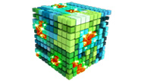


Developer Tools - Debuggers
NSIGHT
CUDA-GDB
CUDA MEMCHECK
NVIDIA Provided
3rd Party
https://developer.nvidia.com/debugging-solutions

Slide 65
Compiler Flags
Remember there are two compilers being used
NVCC: Device code
Host Compiler: C/C++ code
NVCC supports some host compiler flags
If flag is unsupported, use –Xcompiler to forward to host
e.g. –Xcompiler –fopenmp
Debugging Flags
-g: Include host debugging symbols
-G: Include device debugging symbols
-lineinfo: Include line information with symbols

Slide 66
CUDA-MEMCHECK
Memory debugging tool
No recompilation necessary
%> cuda-memcheck ./exe
Can detect the following errors
Memory leaks
Memory errors (OOB, misaligned access, illegal instruction, etc)
Race conditions
Illegal Barriers
Uninitialized Memory
For line numbers use the following compiler flags:
-Xcompiler -rdynamic -lineinfo
http://docs.nvidia.com/cuda/cuda-memcheck

Slide 67
Example 2: CUDA-MEMCHECK
Instructions:
Build & Run Example 2
Output should be the numbers 0-9
Do you get the correct results?
Run with cuda-memcheck
%> cuda-memcheck ./a.out
Add nvcc flags “–Xcompiler –rdynamic –lineinfo”
Rebuild & Run with cuda-memcheck
Fix the illegal write
http://docs.nvidia.com/cuda/cuda-memcheck

Slide 68
CUDA-GDB
cuda-gdb is an extension of GDB
Provides seamless debugging of CUDA and CPU code
Works on Linux and Macintosh
For a Windows debugger use NSIGHT Visual Studio Edition
http://docs.nvidia.com/cuda/cuda-gdb

Slide 69
Example 3: cuda-gdb
Instructions:
Run exercise 3 in cuda-gdb
%> cuda-gdb --args ./a.out
Run a few cuda-gdb commands:
(cuda-gdb) b main //set break point at main
(cuda-gdb) r //run application
(cuda-gdb) l //print line context
(cuda-gdb) b foo //break at kernel foo
(cuda-gdb) c //continue
(cuda-gdb) cuda thread //print current thread
(cuda-gdb) cuda thread 10 //switch to thread 10
(cuda-gdb) cuda block //print current block
(cuda-gdb) cuda block 1 //switch to block 1
(cuda-gdb) d //delete all break points
(cuda-gdb) set cuda memcheck on //turn on cuda memcheck
(cuda-gdb) r //run from the beginning
Fix Bug
http://docs.nvidia.com/cuda/cuda-gdb

Slide 70
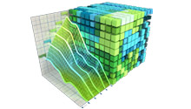
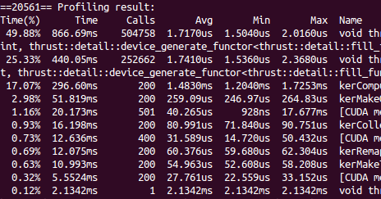


Developer Tools - Profilers
NSIGHT
NVVP
NVPROF
NVIDIA Provided
TAU
VampirTrace
3rd Party
https://developer.nvidia.com/performance-analysis-tools

Slide 71
NVPROF
Command Line Profiler
Compute time in each kernel
Compute memory transfer time
Collect metrics and events
Support complex process hierarchy's
Collect profiles for NVIDIA Visual Profiler
No need to recompile

Slide 72
Example 4: nvprof
Instructions:
Collect profile information for the matrix add example
%> nvprof ./a.out
How much faster is add_v2 than add_v1?
View available metrics
%> nvprof --query-metrics
View global load/store efficiency
%> nvprof --metrics gld_efficiency,gst_efficiency ./a.out
Store a timeline to load in NVVP
%> nvprof –o profile.timeline ./a.out
Store analysis metrics to load in NVVP
%> nvprof –o profile.metrics --analysis-metrics ./a.out

Slide 73
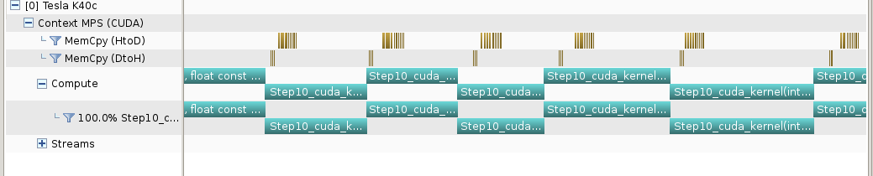
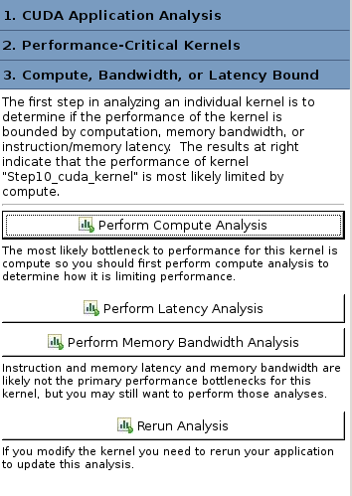
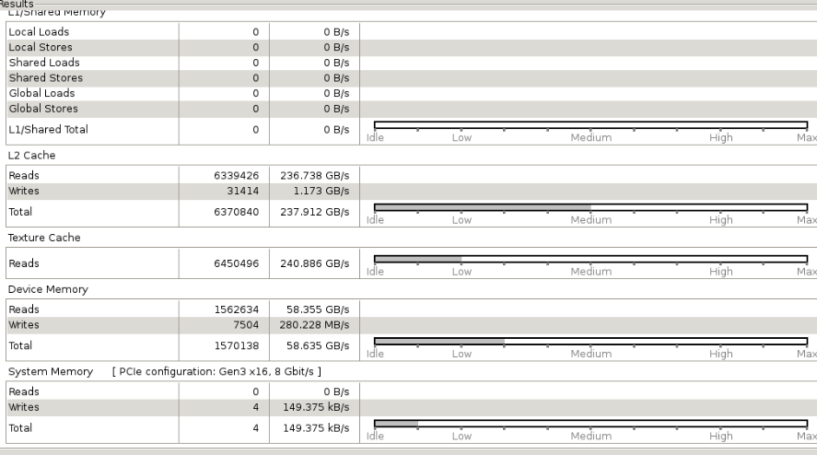
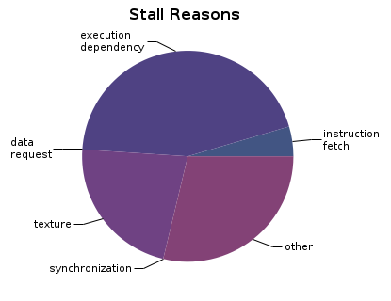
NVIDIA’s Visual Profiler (NVVP)
Timeline
Guided System
Analysis

Slide 74
Example 4: NVVP
Instructions:
Import nvprof profile into NVVP
Launch nvvp
Click File/ Import/ Nvprof/ Next/ Single process/ Next / Browse
Select profile.timeline
Add Metrics to timeline
Click on 2nd Browse
Select profile.metrics
Click Finish
Explore Timeline
Control + mouse drag in timeline to zoom in
Control + mouse drag in measure bar (on top) to measure time

Slide 75

Example 4: NVVP
Instructions:
Click on a kernel
On Analysis tab click on the unguided analysis
Click Analyze All
Explore metrics and properties
What differences do you see between the two kernels?
Note:
If kernel order is non-deterministic you can only load the timeline or the metrics but not both.
If you load just metrics the timeline looks odd but metrics are correct.

Slide 76
Example 4: NVVP
Let’s now generate the same data within NVVP
Instructions:
Click File / New Session / Browse
Select Example 4/a.out
Click Next / Finish
Click on a kernel
Select Unguided Analysis
Click Analyze All

Slide 77
NVTX
Our current tools only profile API calls on the host
What if we want to understand better what the host is doing?
The NVTX library allows us to annotate profiles with ranges
Add: #include <nvToolsExt.h>
Link with: -lnvToolsExt
Mark the start of a range
nvtxRangePushA(“description”);
Mark the end of a range
nvtxRangePop();
Ranges are allowed to overlap
http://devblogs.nvidia.com/parallelforall/cuda-pro-tip-generate-custom-application-profile-timelines-nvtx/

Slide 78
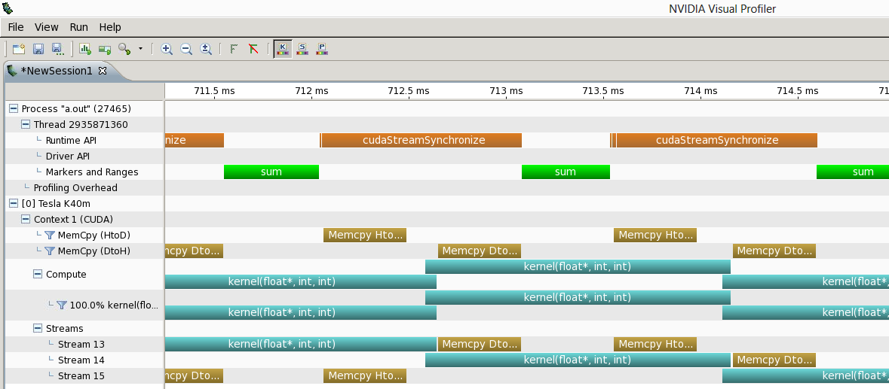
NVTX Profile

Slide 79
NSIGHT
CUDA enabled Integrated Development Environment
Source code editor: syntax highlighting, code refactoring, etc
Build Manger
Visual Debugger
Visual Profiler
Linux/Macintosh
Editor = Eclipse
Debugger = cuda-gdb with a visual wrapper
Profiler = NVVP
Windows
Integrates directly into Visual Studio
Profiler is NSIGHT VSE

Slide 80
Example 4: NSIGHT
Let’s import an existing Makefile project into NSIGHT
Instructions:
Run nsight
Select default workspace
Click File / New / Makefile Project With Existing CodeTest
Enter Project Name and select the Example15 directory
Click Finish
Right Click On Project / Properties / Run Settings / New / C++ Application
Browse for Example 4/a.out
In Project Explorer double click on main.cu and explore source
Click on the build icon
Click on the run icon
Click on the profile icon

Slide 81
Profiler Summary
Many profile tools are available
NVIDIA Provided
NVPROF: Command Line
NVVP: Visual profiler
NSIGHT: IDE (Visual Studio and Eclipse)
3rd Party
TAU
VAMPIR

Slide 82
Optimization
Assess
Optimize
Deploy
Parallelize

Slide 83
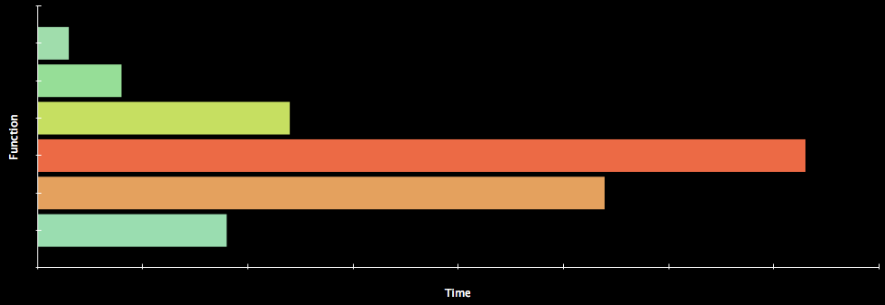
Assess
HOTSPOTS
Profile the code, find the hotspot(s)
Focus your attention where it will give the most benefit

Slide 84
Parallelize
Applications
Libraries
Compiler Directives
Programming Languages

Slide 85
Optimize
Timeline
Guided System
Analysis

Slide 86
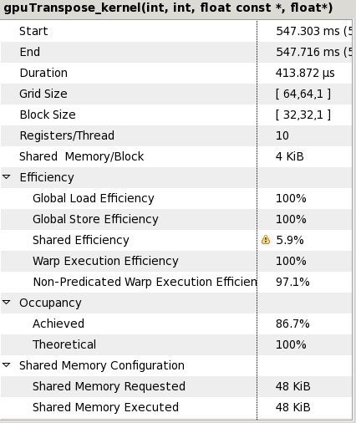
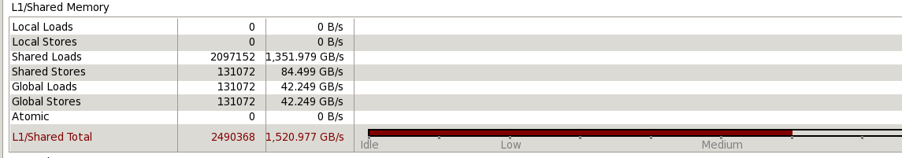
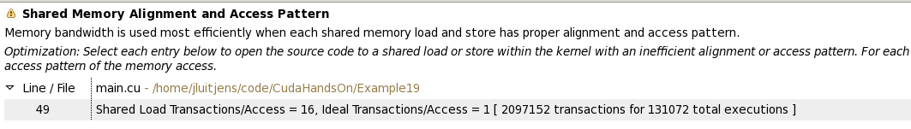
Bottleneck Analysis
Don’t assume an optimization was wrong
Verify if it was wrong with the profiler
129 GB/s 84 GB/s

Slide 87
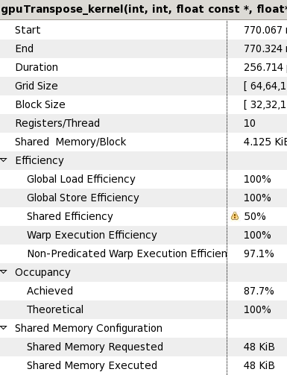
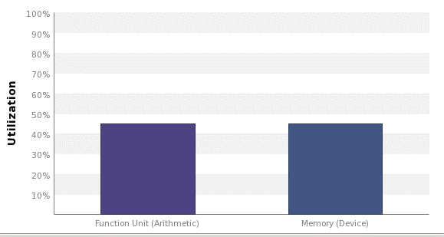
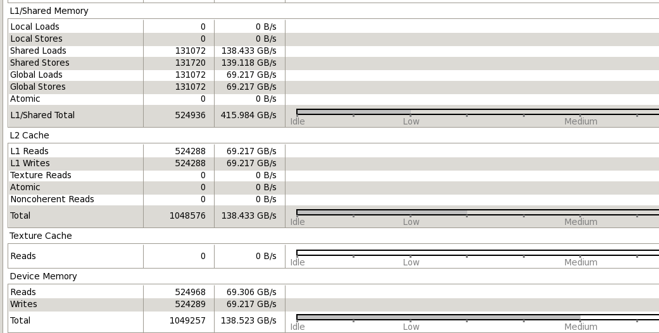
Performance Analysis
84 GB/s 137 GB/s

